Slide 1

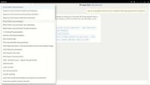
WORKFORCE OPTIMIZATION
Use Generative AI to Improve Worker Efficiency and Skilling
Create Enterprise Chat GPT Resources
Domain specific chats
Open AI Chat GPT + Azure

